Slide 1





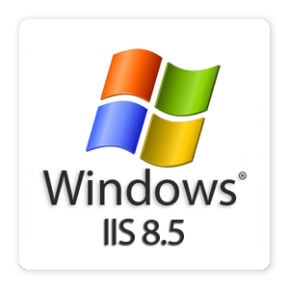

IIS and Deployment of ASP.NET Applications
ASP.NET MVC
Telerik Software Academy
http://academy.telerik.com

Slide 2
Table of Contents
IIS Intro & History
Installing IIS / IIS Express
Deploying ASP.NET Apps in IIS
Sites, Application Pools, Applications
Deploying Simple ASP.NET application
Deployment of Data-Driven application
Web Publishing from Visual Studio

Slide 3

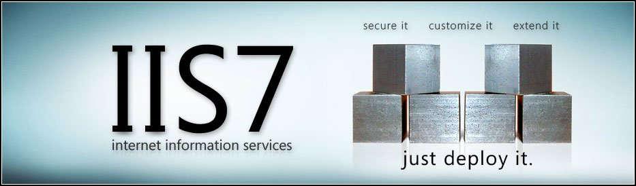
Internet Information Services (IIS 6.0 / 7.0 / 7.5 / 8.0)

Slide 4
Internet Information Services
IIS is a Web server (HTTP server)
Microsoft's Web server
Part of Windows Server
Can process static and dynamic content (through the ISAPI interface)
Handles ASP.NET requests through the ISAPI extension for .NET Framework
w3wp.exe hosts the application pools which host the ASP.NET runtime and ASP.NET apps
ISAPI filter – aspnet_filter.dll

Slide 5

IIS – Versions
IIS 5.1 (Windows XP)
10 simultaneous connections, a single Web site
IIS 6.0 (Windows Server 2003)
Faster and more secure, application pools
IIS 7.0 (Windows Vista / Server 2008)
Can restrict machine resources per user / app
IIS 7.5 (Windows 7 / Server 2008 R2)
IIS Express – limited developer edition
IIS 8 (Windows Server 2012)
IIS 8.5 (Windows Server 2012 R2)

Slide 6
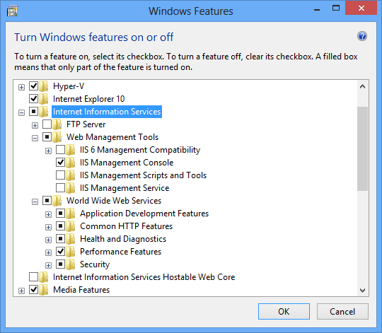
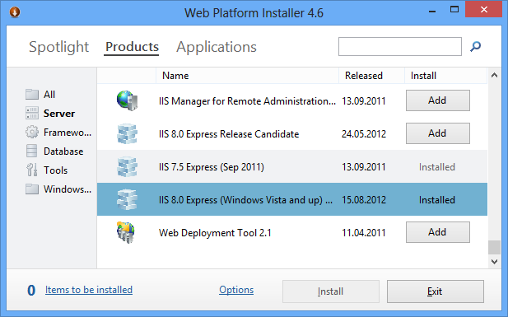

Installing IIS
Turn On / Off Windows Features, Web Platform Installer

Slide 7
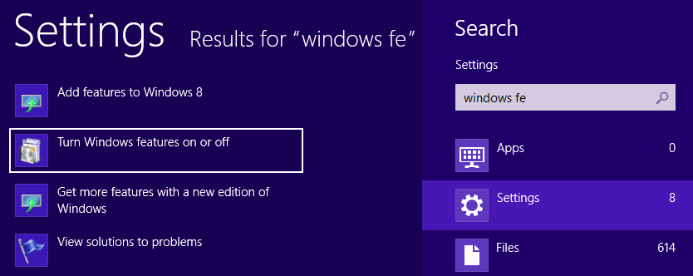
Installing IIS
IIS is part of Windows (Win7, Win8, Windows Server 2008, Windows Server 2012, …)
Installed by "Turn Windows features on or off"

Slide 8
Installing IIS (2)
Select Internet Information Services + ASP.NET 4.5 + IIS Management Console

Slide 9
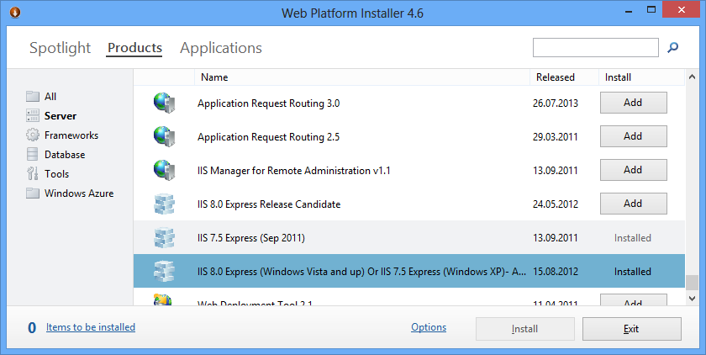
Web Platform Installer
Web Platform Installer (Web PI)
Installs Web servers, applications and tools

Slide 10



Deploying ASP.NET Apps in IIS
Sites, Applications, Application Pools, Databases

Slide 11
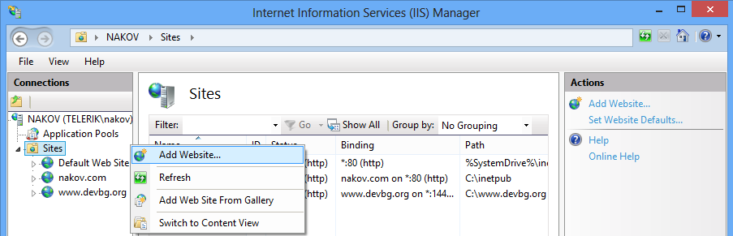
Web Sites in IIS
Sites in IIS
Instances of the Web server
Hosting files and applications
Bind to some protocol + host + port
E.g. http://site.com, https://localhost:8443

Slide 12
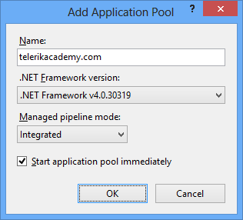
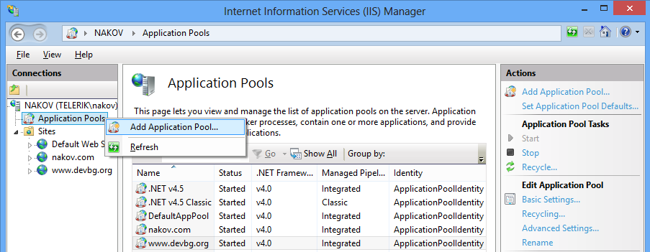
Application Pools in IIS
Application Pools host Web applications in IIS
A process group that run the ASP.NET runtime
Can configure CPU usage, memory limits, identity (local user that owns the processes)

Slide 13
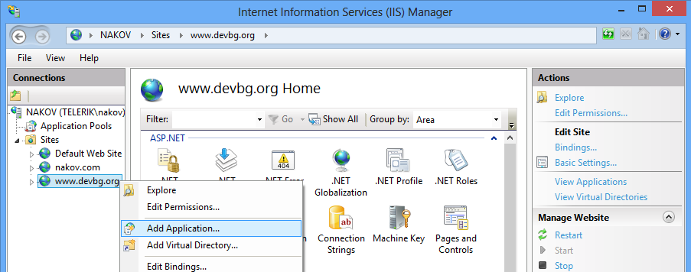
Applications in IIS
Applications in IIS:
Physical directory with files (application code)
Belong to some existing Web site
Run in some existing application pool

Slide 14
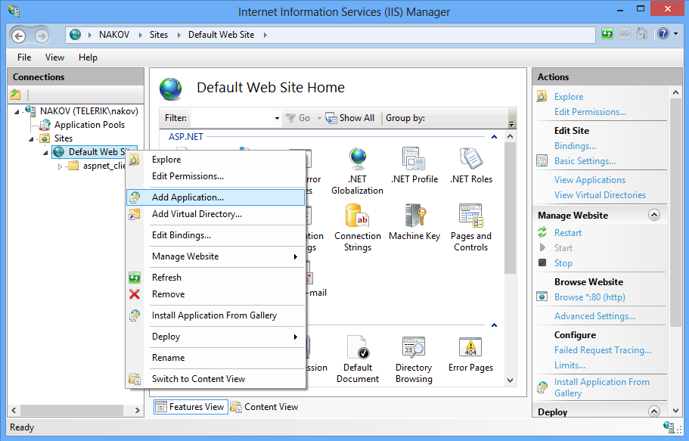
Creating an Application in IIS

Slide 15
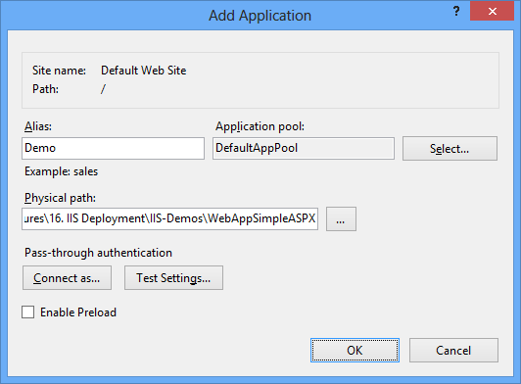
Creating an Application in IIS (2)

Slide 16
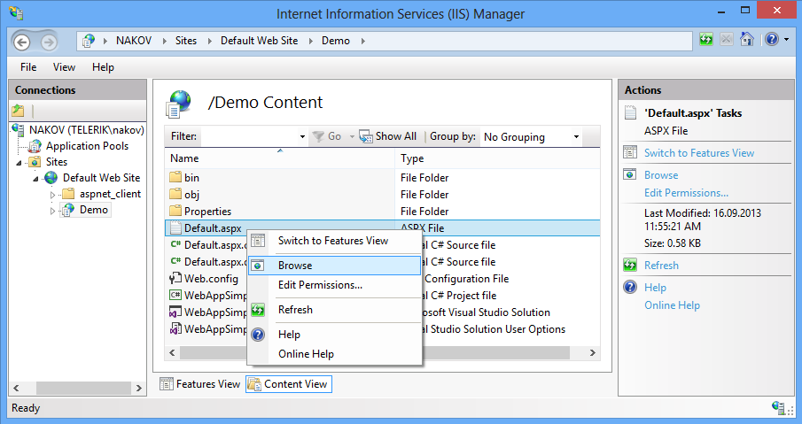
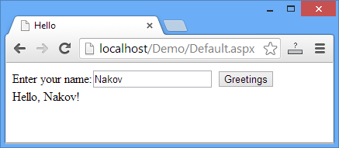
Creating an Application in IIS (3)

Slide 17

Hosting Simple ASP.NET Application in IIS
Live Demo

Slide 18
What Files to Deploy?
Files to copy to the IIS application directory:
Pages & controls: *.aspx, *.Master, *.ascx
Resources: *.jpg, *.png, *.gif , *.css, *.js
Compiled C# files: bin\*.dll
Config files: Web.config, Global.asax
Don't deploy these files:
Source code: *.cs, *.csproj, *.sln
Databases: *.mdf / *.ldf (deploy separately)

Slide 19
Configuring Database Permissions for SQL Server
Typically in IIS your application runs under the user "IIS APPPOOL\DefaultAppPool"
It has no access to SQL Server by default
To access SQL Server DB from IIS:
Change the connection string in Web.config during the deployment
Create a user "IIS APPPOOL\DefaultAppPool" for your DB in SQL Server
Assign "db_owner" database role

Slide 20
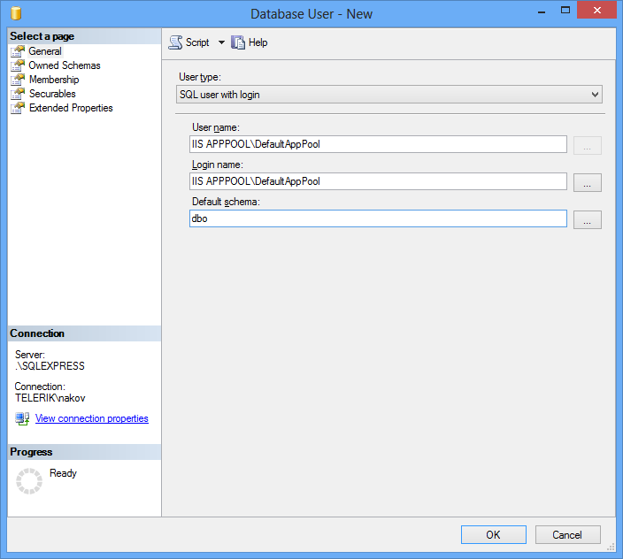
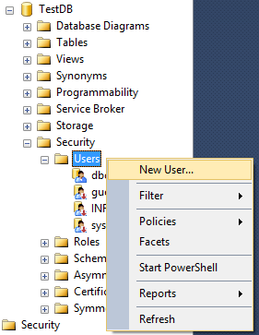
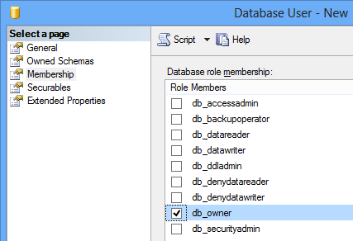
Creating IIS user in SQL Server
Creating and configuring the "IIS APPPOOL\DefaultAppPool" in SQL Server

Slide 21
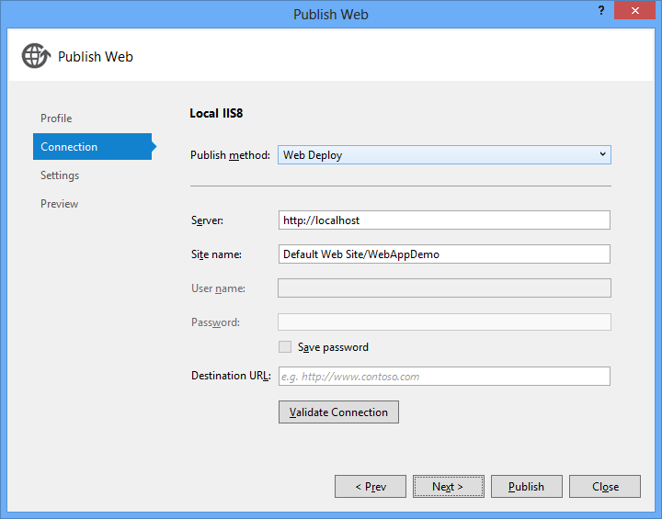


Web Publishing from VS
Publish Web App from VS to IIS

Slide 22
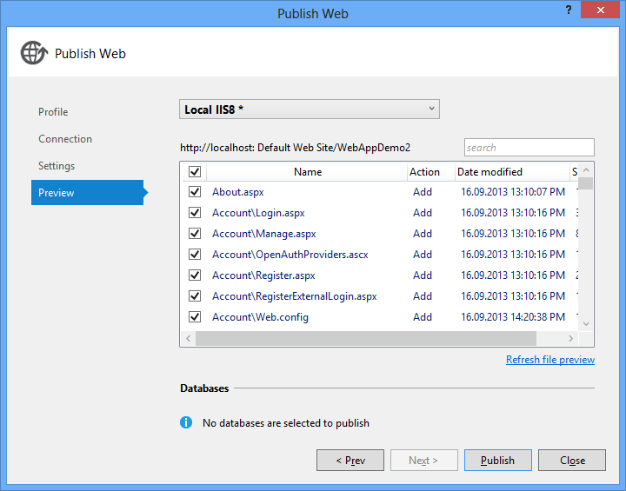
Web Publishing in VS
Visual Studio have a Web Publishing wizard
Deploys ASP.NET apps to remote IIS

Slide 23
Web Publishing from VS
Live Demo

Slide 24
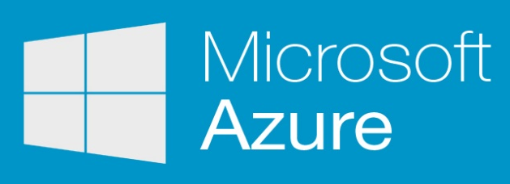
Publish to Microsoft Azure
Live Demo PLEASE WORK, PLEASE WORK, PLEASE WORK!

Slide 25
IIS and Deployment of ASP.NET Applications
http://academy.telerik.com

Slide 26
Homework
Deploy a simple ASPX web page (without a database) in IIS manually (don't use any tool).
Create an ASP.NET Web application that displays some data from the Northwind database. Deploy the application is IIS through Visual Studio.
* Create a Web app in IIS which saves an empty file in C:\WINDOWS directory. Configure the IIS and directory security so that the IIS process has sufficient permissions to write in this directory.

Slide 27



Free Trainings @ Telerik Academy
"Web Design with HTML 5, CSS 3 and JavaScript" course @ Telerik Academy
html5course.telerik.com
Telerik Software Academy
academy.telerik.com
Telerik Academy @ Facebook
facebook.com/TelerikAcademy
Telerik Software Academy Forums
forums.academy.telerik.com

